Slide 1
Elections in India
Team members:
S. Shaikshavali
P. Jayanath
S. Druvitha
K. Yuvasree

Slide 2
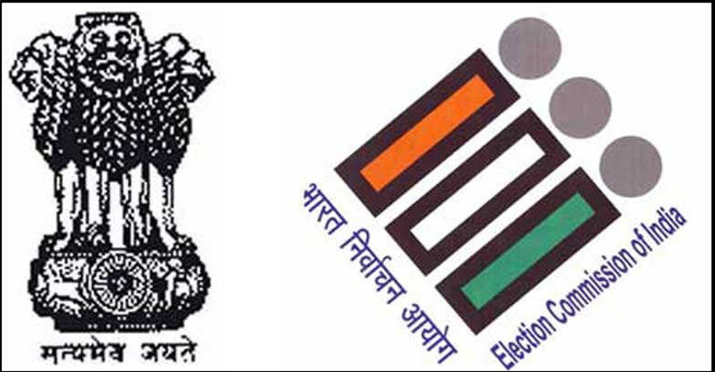
Introduction:
India is the world’s largest democracy, with over 900 million eligible voters.
The election commission of India is responsible for conducting free and fair elections in the country.
Elections in India are held at regular intervals, typically every five years elect members of the Lok Sabha (lower house)and state legislative assemblies.

Slide 3
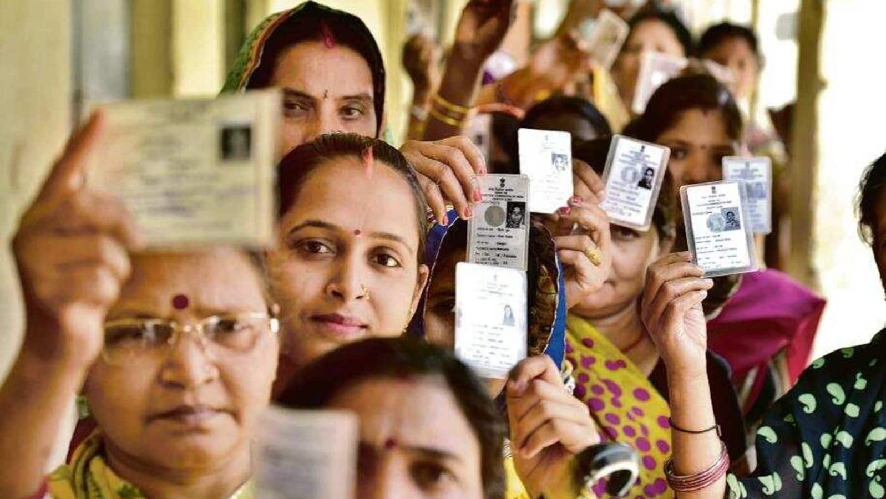
Elections process in India:
The election process in India involves voter registration, candidate nomination, campaigning, voting, and counting of votes.
Electronic voting machines (EVMs) are used for voting, ensuring a fast and efficient process.
Political parties play a significant role in India elections, with candidates representing various parties competing for seats in the parliament and state assemblies.

Slide 4
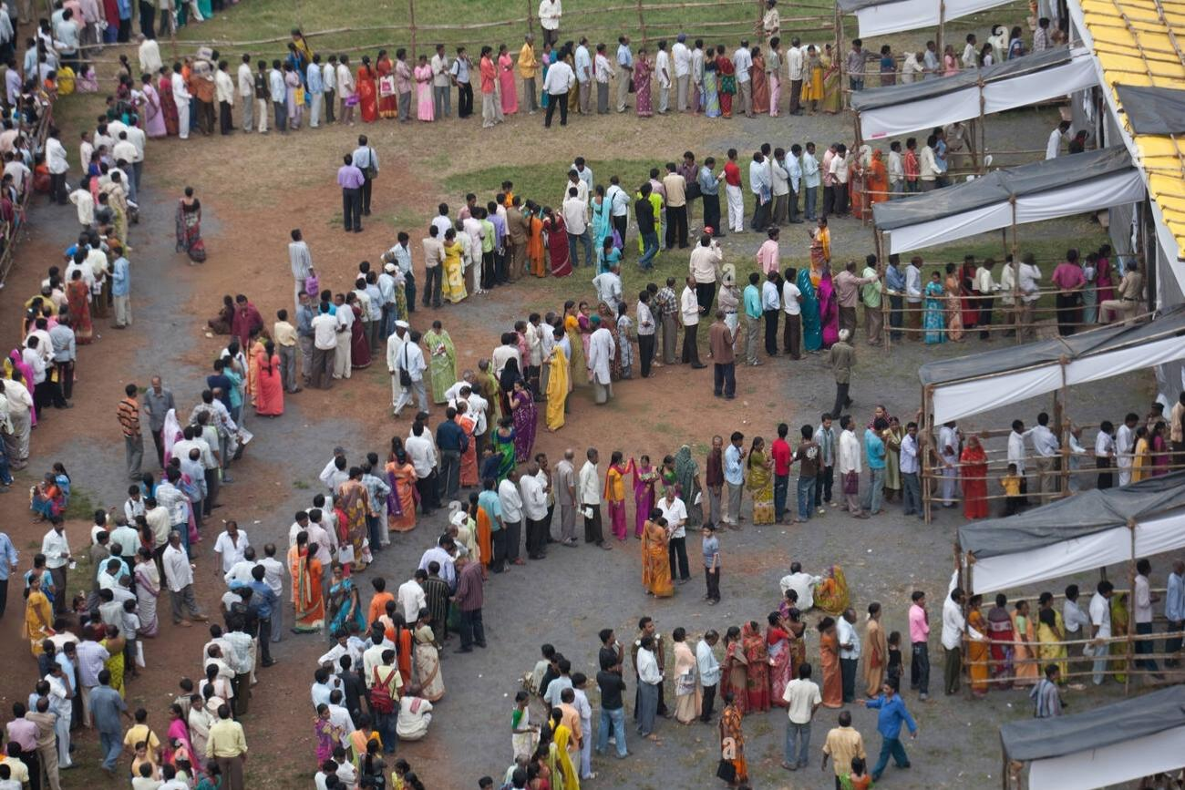
Problems facing by offline voting:
Lack of accessibility: Offline voting methods can be inaccessible to certain groups of voters, such as individuals with disabilities or those living in remote areas with limited access to polling stations.
Potential for voter Fraud: Offline voting can be susceptible to fraudulent activities, including voter impersonation,ballot tampering,and manipulation of vote counts.
Slow and inefficient process:Offline voting often involves manual processes,such as paper-based ballots and manual vote counting, which can lead to delays in the results and inefficiencies in the overall voting process.

Slide 5

Introduction to online elections
Online elections refer to the process of conducting elections using internet –based platforms.
This method allows voters to cast their votes remotely, using electronic devices such as computers or smartphones.
Online elections aim to make the voting process more convenient, accessible,and efficient for eligible voters.

Slide 6

Benifits of online elections
Increased accessibility: Online elections enable voters to participate from anywhere, eliminating geographical barriers.
Cost-effective: Conducting elections online can significantly reduce costs associated with traditional voting methods.
Efficiency and speed: Online voting systems can streamline the entire election process , from registration to vote counting , saving time and resources.
Security concerns: Ensuring the integrity and confidentiality of votes is crucial ,as online elections face potential threats from hacking or tampering.

Slide 7

Implementing online voting
Online voting offers several advantages over traditional voting methods.
It provides convenience and accessibility for voters, allowing them to cast their votes from anywhere with an internet connection.
Online voting can increase voter turnout by removing barriers such as physical distance , long waiting times, and limited polling locations.

Slide 8

Key consideration for implementing online voting
Ensuring the security and integrity of the voting process is crucial . Robust authentication measures must be implemented to prevent fraudulent activities.
A reliable and scalable infrastructure is needed to handle the potentially high volume of simultaneous voters and prevent system crashes.
Accesibility and usability should be prioritized to ensure that online voting is inclusive and easy to use for people of all abilities and technological literacy levels.

Slide 9

Advantages of online voting in India
Increased Accessibility :Online voting allows citizens to vote from anywhere, eleminating the need to travel to polling stations, particularly beneficial for those with physical disabilities or living in remote areas.
Enhanced convenience: With online voting,voters can cast their ballots at any time during the designated voting period, providing flexibility & convenience for busy individuals.
Cost and Time Efficiency: Online voting reduces the need for physical polling stations, resulting in cost savings and quicker vote counting processor, leading to faster results.

Slide 10
The end
Ballot is powerful than bullet
Your vote matters

